Slide 1
Optical Character Recognition (OCR) using Deep Learning
By Gopalakrishnan Kumar, MTech IIT-Bombay,
Freelance Data Science Consultant
LinkedIn: Profile Link : https://www.linkedin.com/in/gopalakrishnankumar-a73301110/
Github:https://www.github.com/Gopalakrishnan-Kumar/
Kaggle URL- https://www.kaggle.com/gopalkk2

Slide 2
Google Colab URL
https://colab.research.google.com/drive/1lWEF0b7yISDRm-MVMF6uL4ia_eqny54U?usp=sharing

Slide 3
Objectives
The main goal of this project is to develop a deep learning-based OCR system that can accurately recognize and classify handwritten digits (0–9) using Convolutional Neural Networks (CNNs). This serves as a foundation for more advanced OCR tasks such as recognizing text in scanned documents or natural images.

Slide 4
Dataset Used
MNIST Handwritten Digit Dataset
60,000 training images and 10,000 testing images
Grayscale, 28×28 pixel images of digits 0–9
Well-balanced across classes

Slide 5
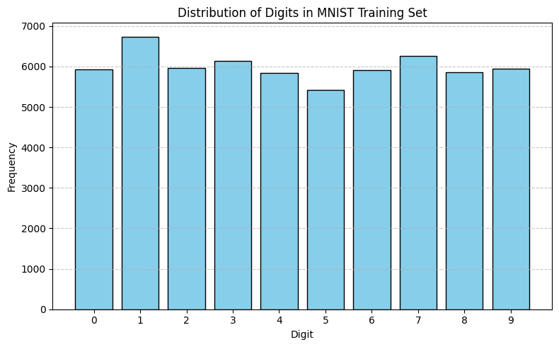
Data Visualization

Slide 6
Model Architecture
A CNN (Convolutional Neural Network) was implemented using TensorFlow/Keras with the following layers:
Conv2D Layer 1: 32 filters, (3×3) kernel, ReLU activation
MaxPooling2D Layer 1: (2×2) pool size
Conv2D Layer 2: 64 filters, (3×3) kernel, ReLU activation
MaxPooling2D Layer 2: (2×2) pool size
Flatten Layer: Converts feature maps to a vector
Dense Layer: 128 neurons, ReLU activation
Output Layer: 10 neurons (softmax for multi-class classification)

Slide 7
Training Details
Loss Function: Sparse Categorical Crossentropy
Optimizer: Adam
Epochs: 5
Validation Split: 10%
Evaluation Metric: Accuracy

Slide 8
Model Performance
Training Accuracy: ~99%
Test Accuracy: ~98.4%
RMSE (Root Mean Squared Error): Not applicable directly but confusion matrix used for classification assessment.

Slide 9
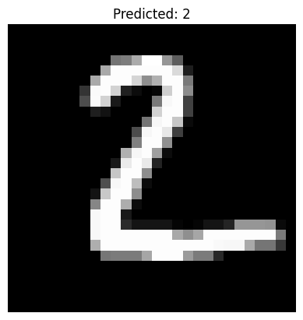
Data Visualization

Slide 10
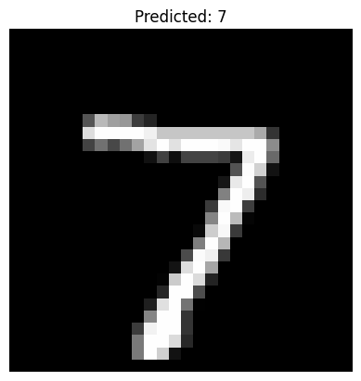
Data Visualization

Slide 11
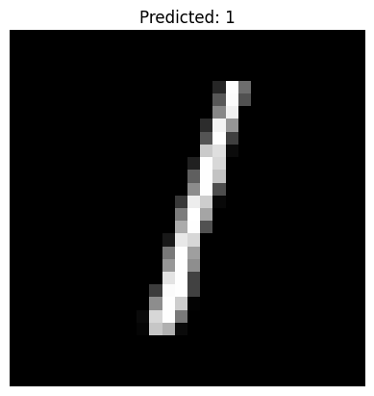
Data Visualization

Slide 12
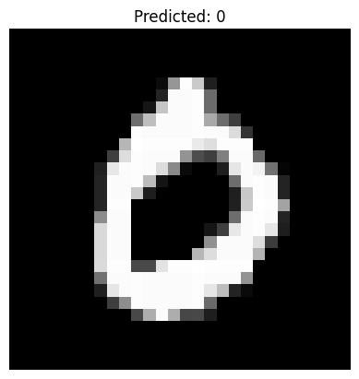
Data Visualization

Slide 13
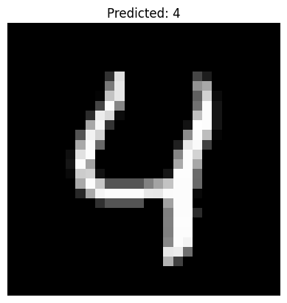
Data Visualization

Slide 14
Common Misclassifications
Digit 4 misclassified as 9
Digit 7 confused with 1
These errors are mostly due to similar visual patterns and handwritten variations

Slide 15
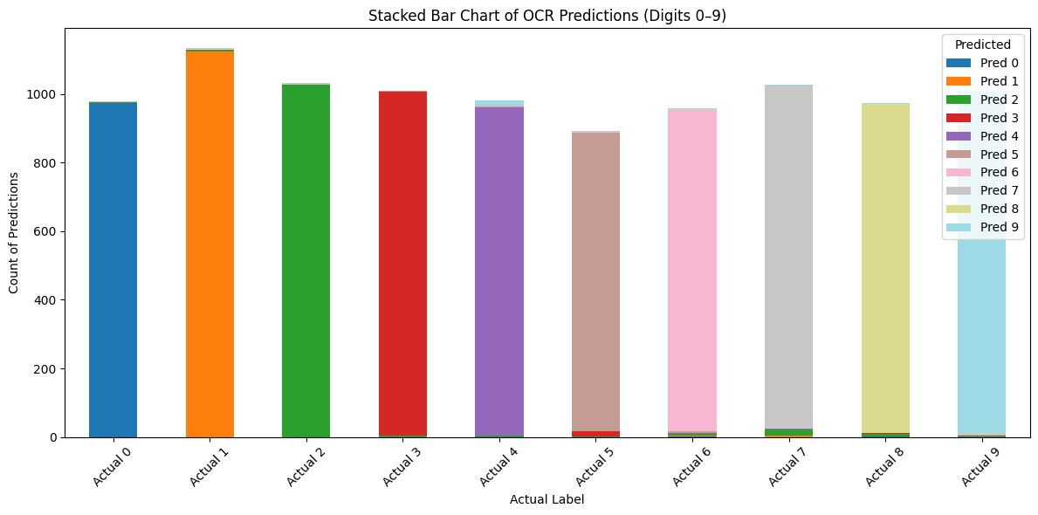
Data Visualization

Slide 16
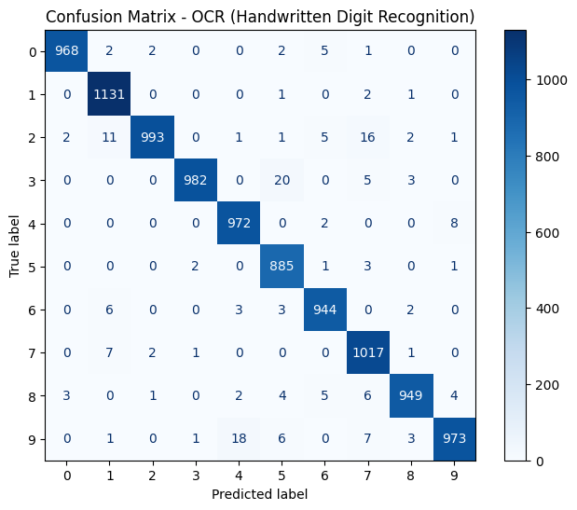
Data Visualization

Slide 17
Key Insights
The CNN model generalizes well on unseen data
Class imbalance is not a major issue in MNIST, but would be in real OCR tasks
Misclassification is often due to poor image quality or ambiguous handwriting

Slide 18
Possible Improvements
Data Augmentation: Rotate, scale, or shift digits to improve robustness
Use of CRNN (CNN + RNN + CTC Loss): For real sequence text detection
Real-World Dataset: Move from MNIST to IAM or printed text datasets
Transfer Learning: Apply pretrained models on image classification for better results

Slide 19
Applications
Automated form reading
Postal address recognition
Bank cheque digit extraction
License plate recognition

